Slide 1
Unveiling Zurich's Canine Community
A Data-Driven Exploration

Slide 2
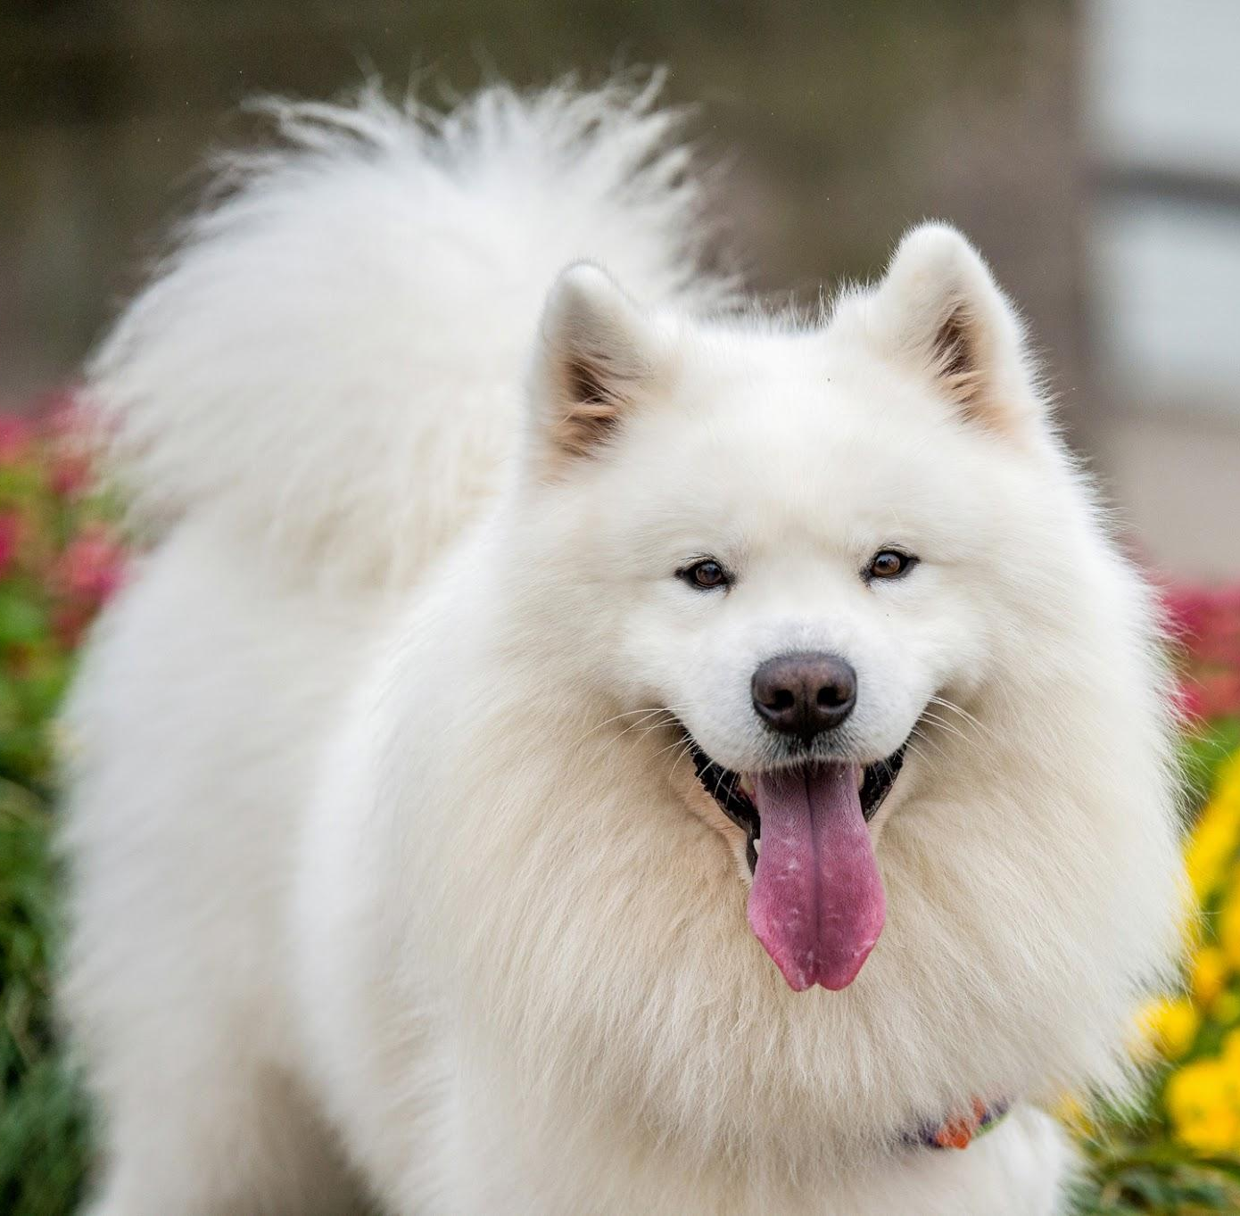
Introduction
Comprehensive analysis of Zurich’s canine population, exploring intriguing trends in dog ownership, and gaining unique insights about the city’s beloved four-legged companions.

Slide 3
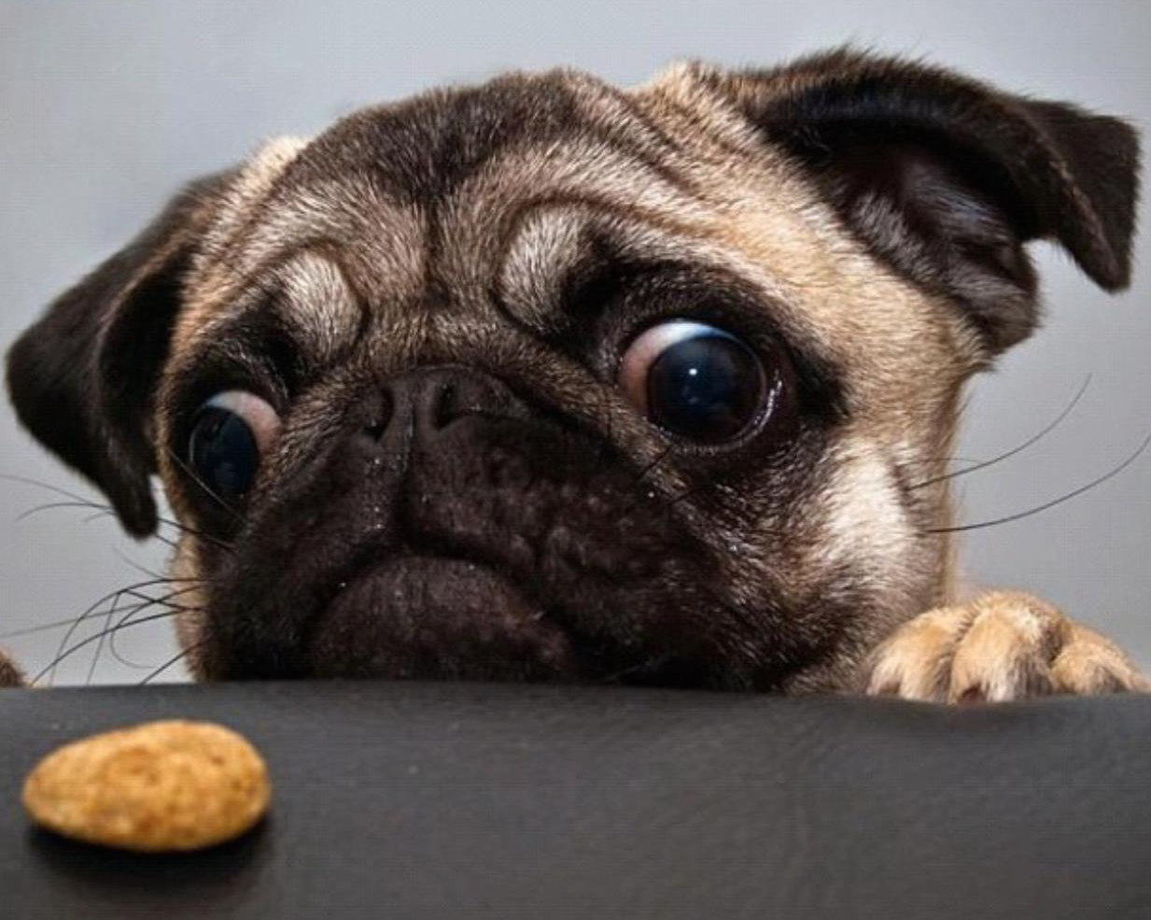
Data Sources
The analysis is based on two key datasets:
Dog_owners
Dog_breeds
Covering the years 2015, 2016 and 2017.
Provided a detailed view of Zurich’s dog ownership landscape.

Slide 4
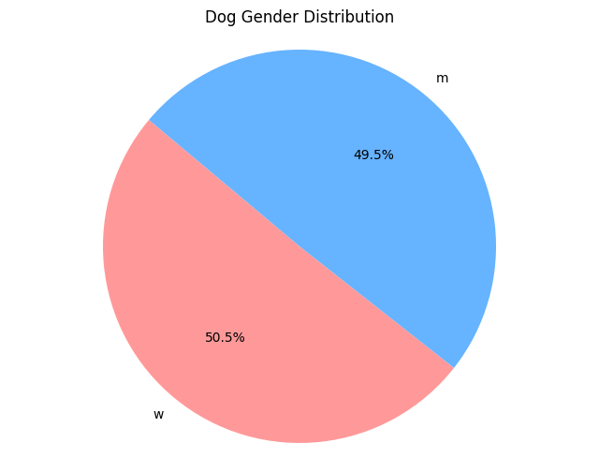
Dog Gender Distribution
We observe a nearly balanced gender distribution among dogs, with a slight majority of female dogs, suggesting no strong gender preference in Zurich's canine population.

Slide 5
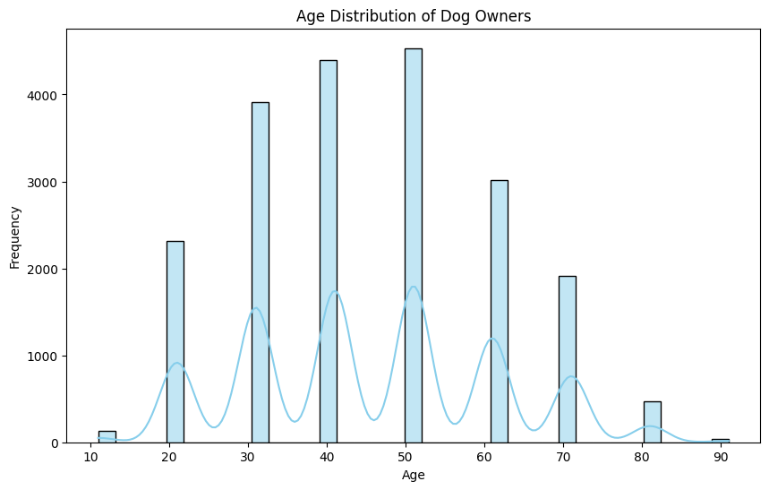
Age Distribution of Dog Owners
The majority of dog owners fall within the 40-59 age bracket, indicating a trend where mid-aged individuals are more inclined towards dog ownership.

Slide 6
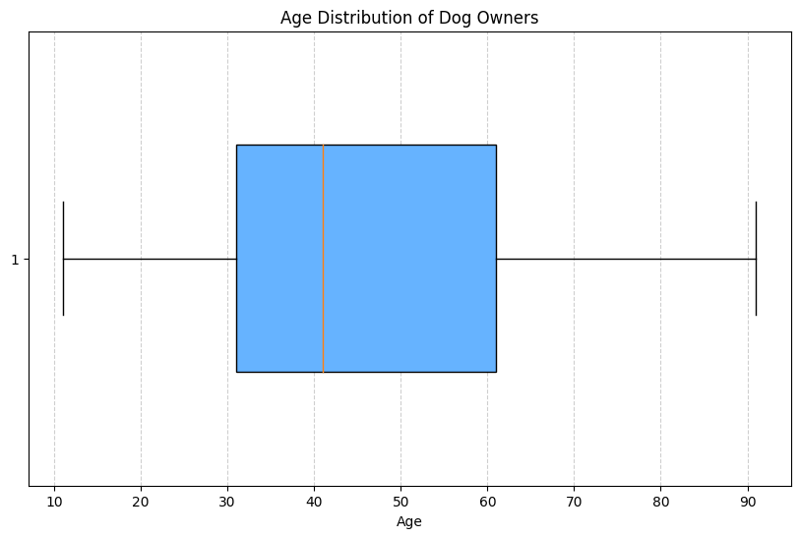
Boxplot Analysis
The boxplot reveals a fairly symmetrical age distribution among dog owners, with a median age slightly skewed towards younger owners, but without extreme outliers.

Slide 7
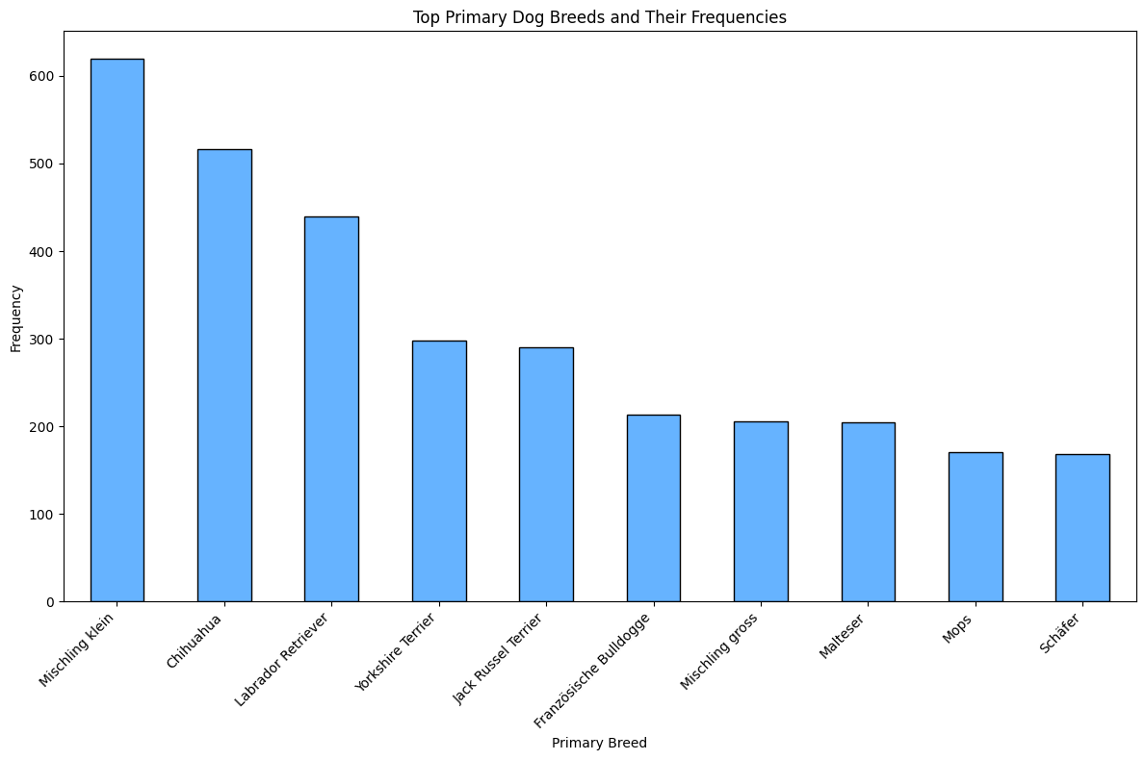
Breed Popularity
Popular breeds include 'Mischling Klein' (Mixed breed small), Chihuahua, and Labrador Retriever, highlighting a diverse range of preferences, with mixed breeds being particularly favored.

Slide 8
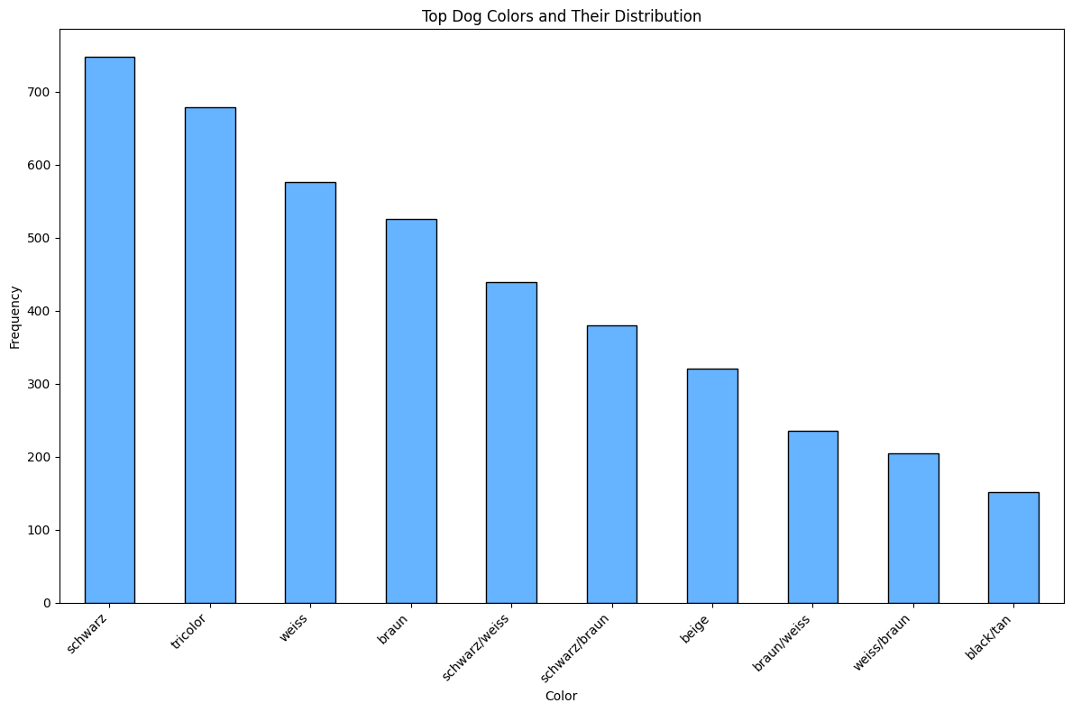
Dog Color Trends
Black, brown, and white dominate the color spectrum of dogs in Zurich, with a notable variety in color choices, reflecting a diverse canine community.

Slide 9
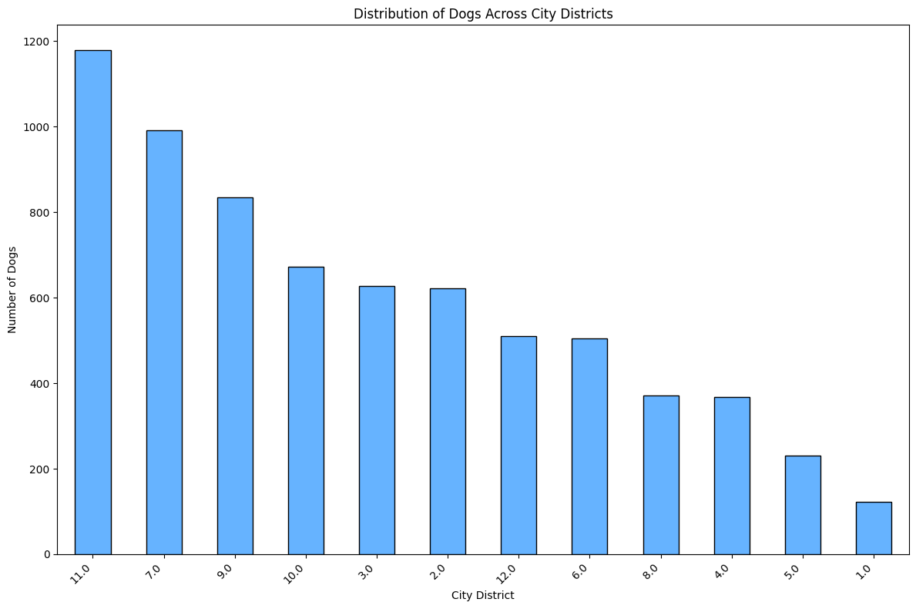
District-wise Dog Ownership
There's a significant variation in dog ownership across districts, with District 9 leading, suggesting environmental and socio-economic influences on pet ownership.

Slide 10
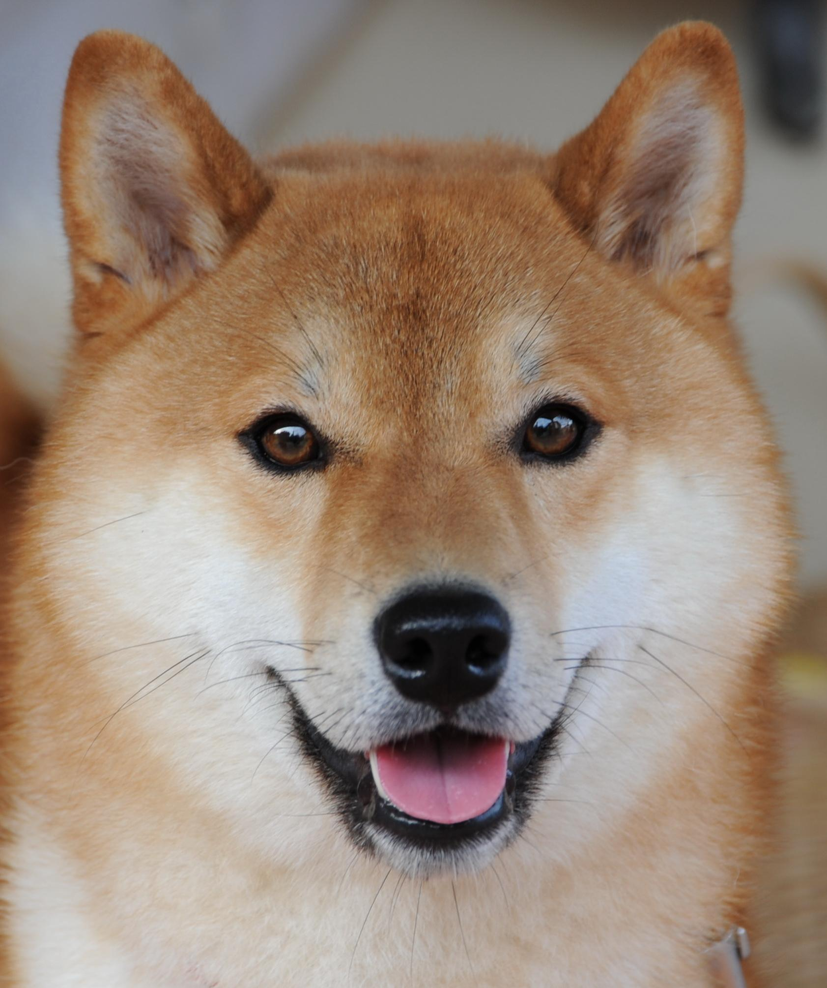
Conclusions
The analysis uncovers key trends in Zurich’s canine community, offering valuable insights for businesses, city planners, and residents alike in understanding and catering to the needs of dog owners and their pets.

